Slide 1
MSC + and MSHO 101
Laying the Foundation for Effective Care Coordination
Notes:
Welcome to UCare’s MCS+ and MSHO 101 -

Slide 2
MSC+ & MSHO Overview
Plan Descriptions
Benefits
Regulations, Requirements and Purpose!
DHS and CMS
Care Coordination Purpose
Care Coordination Tasks
Assessment
Qualifying for MSC+ & MSHO
Support Planning
Ongoing Case Management
Enrollment and Assignment
To Learn More:
Click the link to read more on the subject. Bookmark link for easy reference.
Notes:
The MSC+ MSHO Care Coordination 101 is a series of trainings divided into 3 companion modules.
Part One is. An Overview of MSC+ and MSHO – this includes understanding the difference between the MSC+ and MSHO plans, an introduction into the covered benefits as well as the member enrollment and assignment process. The 2nd course is Care Coordination Rules/requirement and regulations.
In part 2, you will learn about how care coordination is regulated, the UCare Requirements Gids (the policies/procedures for care coordination as well as the roles and purpose of the care coordinator.
Part Three includes the 3 essential tasks of a CC, Assessment Support Planning and Ongoing Case mgt.
Throughout the learning modules you will find opportunities “to learn more”. These links are intended to be reviewed independently and bookmarked for easy reference.
Supplemental learning modules on the topics of TOC and Gaps in Care complete the Foundations of Effective Care Coordination. We thank you for participating. Let’s get started.

Slide 3
Part One: MSC+ & MSHO
A Brief Overview

Slide 4
People Powered Health Plans
UCare offers two senior health plans:
Minnesota Senior Care Plus (MSC+) A mandatory prepaid Medical Assistance Program for people over age 65. MSC+ replaces fee-for-service Medical Assistance (MA). All care covered by Medical Assistance is covered by MSC+. Members may or may not have Medicare A/B/D coverage.
Note: Dual eligible members may elect to keep their MA and Medicare separate. In this case – Medicare is the Primary (first payor) insurance and UCare’s MSC+ is Secondary (second payor)
UCare’s Minnesota Senior Health Options (MSHO) A voluntary Minnesota Health Care Program for MA and Medicare eligible individuals. MSHO combines both MA and Medicare into one health plan administered by UCare.
Both MSC+ and MSHO have the benefit of an assigned Care Coordinator.
To Learn More:
DHS Health Care Programs & Services: Health Care Programs and Services
DHS Minnesota Health Care Programs Provider Manual (MA coverage guide)

Slide 5
MSC + Benefits Overview
MSC + Coverage includes all services as covered by traditional Fee-For-Service Medical Assistance. See below for a brief list of coverage. Members who have Medicare A, B & D would have THREE insurances cards. One for Medicare A/B, One for MA benefits (UCare MSC+) and one for Medicare Part D (medications)
Medical / Clinic Visits
Preventative Care (cancer screenings, annual wellness visits and vaccinations)
Laboratory Tests
Emergency Room Care
Hospital Care
PT/OT and Home Care Services
Vision/Dental/Auditory Care
Mental Health and Substance Use Disorder Supports
Medications (MHCP Formulary*) if not enrolled in Medicare Part D *includes some OTC Medications
Chiropractic, Acupuncture and Podiatry Services
Medical Equipment
Interpreter Services
Transportation to covered medical services
To Learn More:
MSC+ Overview
DHS Minnesota Health Care Programs Provider Manual (MA coverage guide)
Medical Supply Coverage Guide
Community Based Services Manual (CBSM)

Slide 6
MSHO Benefits Overview
MSHO Combines medical assistance benefits with Medicare A, B, D benefits. Members have ONE UCare MSHO insurance card for all coverage.
All covered supports as noted for MSC+
Additional Supplemental Benefits (updated annually) Evidenced Based supports and services aimed to improve health and reduce overall cost of care.
Fitness Benefits
Rewards and Incentives Example: Visa cash rewards/incentives aimed at reducing Gaps in Preventative Care screenings.
Medications (UCare Formulary) and some OTC Medications
90 Days of continued coverage for members who lose medical assistance coverage
To Learn More:
Additional & Supplemental Benefits
MSHO Overview
MSC+ MSHO Comparison
Notes:
MSHO combines a members Medicare benefits with their medical assistance coverage. Member have ONE UCare MSHO insurance care for all coverage.
In addition to all things covered by MC and MA, MSHO offer a host of supplemental benefits which are updated annually. These unclude

Slide 7
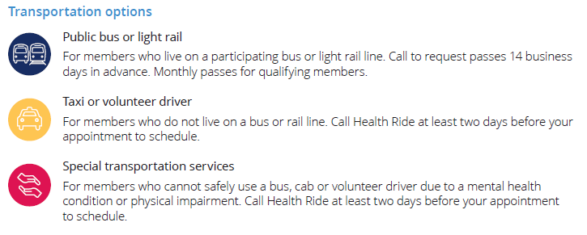
Transportation
UCare’s Health Ride provides no-cost transportation to and from UCare covered medical, dental and pharmacy visits to members who do not have their own means of transportation. The 30/60-mile rule applies to primary and specialty care transportation needs.
Rides may be requested via phone (2-day advance request) or email form (3-day advance request), Monday-Friday during business hours.
To Learn More:
UCare Health Ride
Job Aid: Transportation
Notes:
See the To Learn More section below to learn more about UCare’s health ride and how Care Coordinators can assist members with arranging transportation.

Slide 8
Explore Supplemental Benefits
Care Coordinators can locate the Additional and Supplemental Benefits and Referral Forms, in the Benefits, Perks and Member Handouts Spark.
Notes:
We encourage you to visit the Care Coordination and Care Mgt home page often to take advantage of the resources, tools and information available to care coordinator.

Slide 9
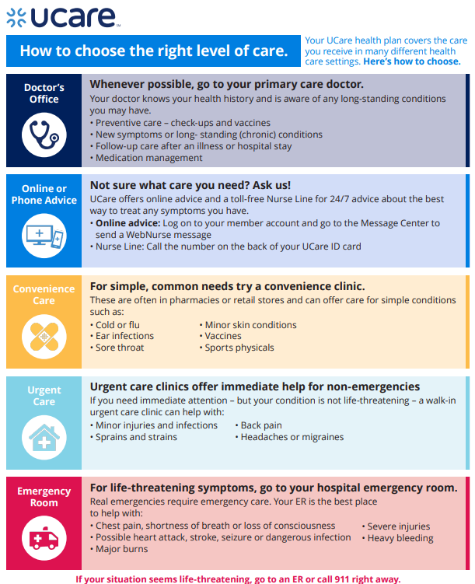
UCare’s Nurse Line
UCare members can call the UCare 24/7 nurse line. Nurses offer health advice when members are not feeling well or can answer health related questions. They can also give advice about whether to go to an urgent care or the emergency room (ER).
Available to all UCare members free of charge.
24 hours, 7 days a week
1-800-942-7858-toll free
Interpreters available as needed
Notes:
Helping member access the right care at the right time is one way cc’s support members. Many educational tools are available in our Member Handouts resource located on the CC web page.

Slide 10
Qualifying for MSC+ & MSHO
How Care Coordinators Receive Members.

Slide 11
Qualifying for MSC+
COR
Person needs medical assistance
Completes application at County of Residence (COR)
MSC+ Criteria
MA Eligible
Managed Care Organization
(MCO)*
UCare members must live in a UCare MSC+ Service Area
Age 65 and better
No Medical Spenddown (income over the MA eligibility limit, pays for a portion of medical costs to meet MA criteria)
Financial Worker at COR determines eligibility
MA financial eligibility is reviewed at least annually by Financial Worker
Either select MSC+ or defaults to MSC+ if no selection made
*A managed care organization (MCO) is a business, like UCare, that manages the delivery of health care services through managed health care plans.
Notes:
Let’s review how our members become enrolled in our People Powered Health Plans.

Slide 12
Qualifying for MSHO
COR
Person needs medical assistance
Completes application at County of Residence (COR)
MSHO
Criteria
MA Eligible
Choose UCare
UCare members must live in a UCare MSHO Service Area
Age 65 and better
Enrolled in Medicare A/B/D
No Medical Spenddown (income over the MA eligibility limit, pays for a portion of medical costs to meet MA criteria)
Financial Worker at COR determines eligibility
MA financial eligibility is reviewed at least annually by Financial Worker
Actively select MSHO as preferred plan
To Learn More:
DHS MSHO: Minnesota Senior Health Options (MSHO) / Minnesota Department of Human Services (mn.gov)
Spenddown: DHS-3017-ENG (state.mn.us) – search via eDocs

Slide 13
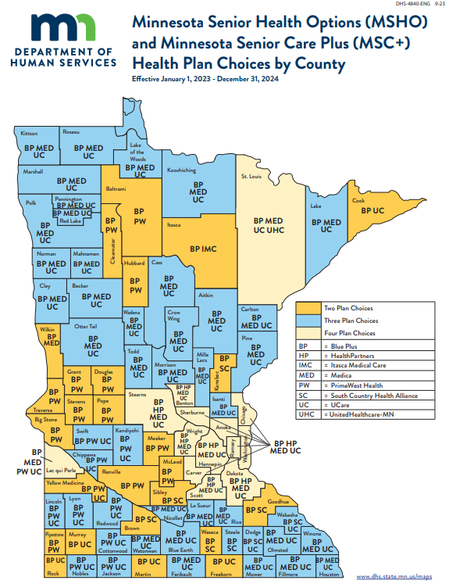
Members receive a notification from the financial worker informing of the options to choose.
If the member does not choose a preferred MCO, DHS will auto enroll in one of the MCO’s in the county.
When eligible, the member must actively choose MSHO or will default to MSC+.
Notify the member’s financial worker if a member relocates to a different county or leaves the state of MN for more than 30 days – it may affect eligibility.
To Learn More:
MSHO Health Plan Choices by County: DHS-4840-ENG 10-23 MSHO Health Plan Choices by County – search via eDocs

Slide 14
Reasons Members May Choose MSHO
90 Days of Continued Coverage
MSHO members who lose Medical Assistance coverage continue to receive MSHO benefits for an additional 90 days.
Supplemental Benefits
UCare’s MSHO offers additional benefits over and above what is covered by Medical Assistance and MSC+. Examples include:
Fitness/exercise membership, special programs, rewards and incentives, food discounts, and more!
Coordinated Benefits
MSHO members get the most out of MA and Medicare benefits through improved coordination, simplifying benefits, and additional services not available via MA. MSHO members have one UCare ID card for Medicare, MA, and medication/Part D benefits. This mean less paperwork!
Notes:
Care Coordinators provide education on health plan benefits. Members who have medicare and are not enrolled in MSHO may ask you why they would want to change plans.
There are several important benefits to enrolling in MSHO.

Slide 15
Continue to Part Two
Regulators, Purpose, Requirements & Enrollment
Notes:
This concludes Part One of the MSC+ MSHO Care coordination 101 series. Please continue to part Two: Regulators, Purpose Requirements and Enrollment

