Slide 1
Introduction to the Institutional Special Needs Plan (I-SNP) 2024

Slide 2
What is ISNP?
ISNP is a type of Medicare Advantage coordinated care plan specifically designed to meet the needs of individuals living in a Long-Term Care facility or Assisted Living facility and require an institutional level of care.
UCare started offering ISNP plans as of January 2021.
Learn more: Advocate Choice Medicare Plans (ISNP) | UCare

Slide 3
Qualifying for ISNP
Residence
Live in an Assisted Living Facility or Nursing Facility
Requirements
Meet Nursing Facility Level of Care criteria
Product Options
Advocate Choice
Eligible for Medicare parts A, B and D
Facility needs to be contracted with UCare delegate
Advocate Plus
Learn more: Advocate Choice Medicare Plans (ISNP) | UCare

Slide 4
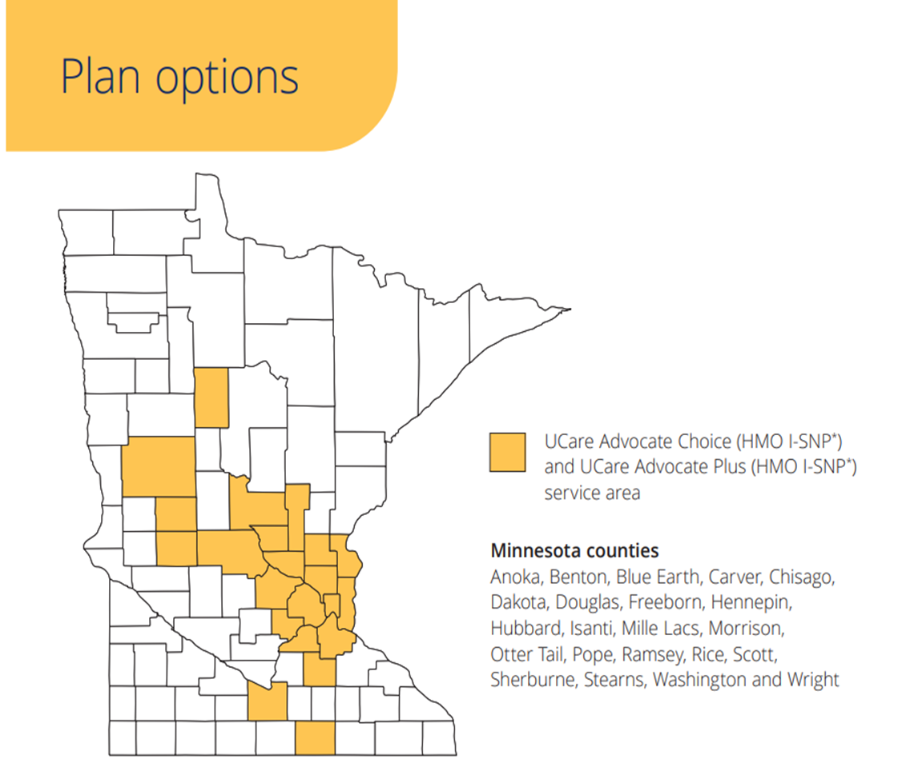
2024 Service Area

Slide 5
Why Choose ISNP?
Care Coordinator
Care Coordinators provide support, education and improve access to health care to optimize health outcomes! They collaborate with members and/or designees, primary care physicians, facility staff, providers, and other specialists to assure appropriateness of service that meets member needs and ensures desired outcomes.
Supplemental Benefits
The UCare ISNP plans offer additional benefits:
Enhanced dental coverage, hearing aide allowance, no-cost routine eye exam, eyewear allowance, Strong and Stable Fall Prevention kit, transportation benefit.
Primary Care where you live
No need to leave your home for primary care visits! Complete care focused on your unique medical and emotional needs.

Slide 6
Care Coordination Makes a Difference!
Assessment
The Care Coordinator completes an annual health risk assessment (HRA) with members to understand the person’s needs and understand how the person is utilizing their health care.
Care Planning
With the member, facility staff and physician, the Care Coordinator develops goals, supports and interventions related to member needs to help the member improve health outcomes.
Ongoing Case Management
The Care Coordinator maintains the relationship with the member throughout the year with regular visits and phone calls based on need. They support members during hospitalizations and through discharge, acting as a “communication bridge" with the member’s care team to ensure they are informed of changes/needs.

Slide 7
How To Enroll
Sales Team: 612-676-6821, 1-877-671-1054
https://www.ucare.org/health-plans/medicare/isnp/enroll-now
Brochures are available in contracted facilities.
People may enroll anytime throughout the year with a start date the 1st of the month after enrollment is completed.
Enroll now: Enroll Now | ISNP | UCare

Slide 8
Questions?
The ISNP Program Coordinator is available to provide support, information, education and regulatory guidance.
ISNPprogramcoordinator@ucare.org
612-627-7252

