Slide 1
Early Intensive Developmental and Behavioral Intervention (EIDBI) Services Training

Slide 2
Table of Contents
1 | Program Overview
2 | Contracting and Credentialing with UCare
3 | Authorization of Services
4 | Claim Submission Reminders
5 | Provider Resources

Slide 3
Program Overview

Slide 4
Early Intensive Developmental and Behavioral Intervention (EIDBI)
Program Information
The Early Intensive Developmental and Behavioral Intervention (EIDBI) Benefit is a Minnesota Health Care Program.
The purpose of the EIDBI Benefit, as identified by the Minnesota Department of Human Services (MN DHS), is to provide medically necessary early intensive intervention for people with autism spectrum disorder (ASD) and related conditions, as well as:
Educate, train and support their parents and families.
Promote people’s independence and participation in family, school and community life.
Improve long-term outcomes and the quality of life for people and their families.
Early Intensive Developmental and Behavioral Intervention (EIDBI) state.mn.us)

Slide 5
Early Intensive Developmental and Behavioral Intervention (EIDBI)
Background Information
The 2013 Minnesota Legislature passed a law to create the EIDBI benefit for children up to age 18 with ASD. Later amendments expanded eligibility to include people under 21 years old with ASD or a related condition.
The federal Centers for Medicare & Medicaid Services approved revised state plan amendments for the EIDBI Benefit in December 2017 (PDF) and December 2018 (PDF).
Before Minnesota created the EIDBI Benefit, DHS gathered input from ASD stakeholders and consulted with local and national experts.
For eligible member guidance, visit: DHS Provider Manual: Early Intensive Developmental and Behavioral Intervention (EIDBI) services

Slide 6
Early Intensive Developmental and Behavioral Intervention (EIDBI)
Eligible UCare Plans
UCare Connect (SNBC)
UCare Connect + Medicare (HMO D-SNP)
Prepaid Medical Assistance Program (PMAP)

Slide 7
Contracting with UCare

Slide 8
UCare Provider Requirements
To be eligible as a UCare EIDBI participating provider, you need to be registered with the Minnesota Department of Human Services (MN DHS).
To view enrollment criteria and process, visit: EIDBI Enrollment Criteria and Forms (state.mn.us)
If you have questions on your enrollment status with DHS, contact the DHS MHCP Provider Resource Center:
Call 651-431-2700 or 1-800-366-5411 8 am to 4:15 pm (closed 12 to 12:45 pm for lunch) Monday through Friday
Website: MHCP Provider Resource Center / Minnesota Department of Human Services (mn.gov)
Enrollment with MN DHS does not mean you are contracted with UCare. See the Join Our Network page if interested in becoming a UCare contracted provider.

Slide 9
Contracting with UCare
Prior to contracting with UCare, providers must be enrolled with Minnesota Health Care Programs (MHCP).
What is the difference between enrolling with MHCP and contracting with UCare?
Enrolling with MHCP: A provider is enrolling with DHS to participate in the Medical Assistance (MA) program.
Contracting with UCare: A provider is entering into a contractual agreement with UCare to service UCare enrollees receiving Medical Assistance (MA).

Slide 10
Contracting with UCare
Start the contracting process here: UCare® - Join Our Network
Use the UCare Contracting Checklist to ensure you have all information needed to submit your application. Complete the online application in its entirety.
Missing and/or incomplete information may result in processing delays and/or closure of your request.
Please note, you are not deemed a UCare Participating Provider until you have a fully executed provider agreement in effect.
If you have questions about your contract after execution regarding products, effective date, services, facilities, etc., please contact providercontracts@ucare.org.
For questions related to billing, please contact our Provider Assistance Center at 612-676-3300 or email pac@ucare.org.
Please note that for EIDBI services, UCare follows DHS guidelines.

Slide 11
Additional Resources
UCare’s Provider Website ensures easy access to a variety of news, authorization grids, manuals, required forms and other resources for health care professionals who provide care to UCare members.
Bookmark these resource pages to quickly find important information needed to effectively work with UCare.
Provider Login, Claims, Billing, Policies & More (ucare.org)
UCare® - Provider News
UCare® - Policies and Resources
The UCare Provider Manual is an extension of your contract. Checking it regularly for updated information and reference material is required.
UCare® - Provider Manual
Use the Provider Manual as the source of truth when doing business with UCare.

Slide 12
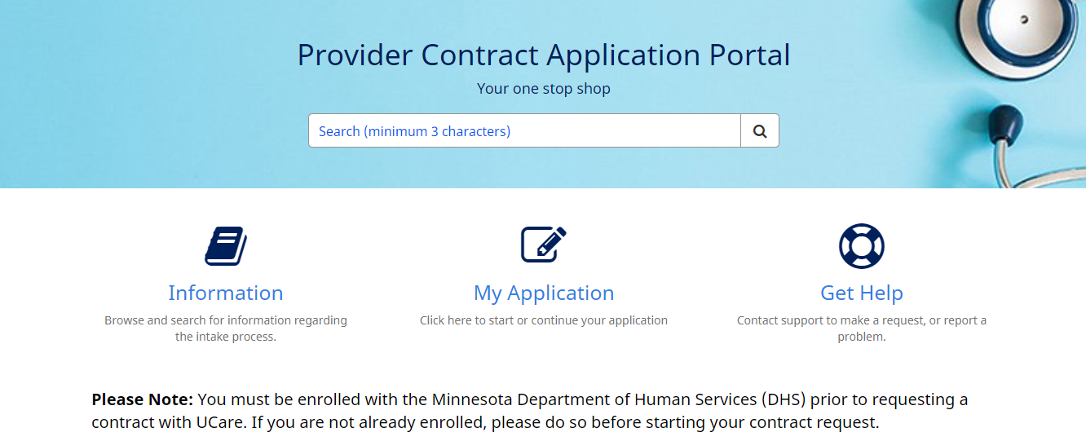
Submission & Questions
Submit all required contracting documents, including your Minnesota Health Care Programs (MHCP) EIDBI enrollment letter, through UCare’s Provider Contract Application Portal.
For UCare contracting request questions, please email providerapp@ucare.org or use the ‘Get Help’ functionality within the Application Portal.

Slide 13
Manage Your Information
To ensure claim payment accuracy, keep your information with UCare up to date:
Facility Tax ID
Legal name or DBA
Address
NPI/UMPI
To update your information, visit the Manage Your Information page on the UCare Provider Website and complete the Facility Change Form/Demographic Change/Update.
To add another location to your current UCare contract, complete the Facility Location Add Form.
You will be notified within 30 calendar days via email when the process is complete.

Slide 14
Credentialing with UCare

Slide 15
Credentialing with UCare
UCare Contracted providers, or those in the process of becoming contracted with UCare, will need to ensure those independently licensed practitioners requiring credentialing have active credentialing with UCare.
What is the difference between Contracting and Credentialing with UCare?
Contracting with UCare: A provider is entering into a contractual agreement with UCare to service UCare enrollees receiving Medical Assistance (MA).
Credentialing with UCare: Verifies a practitioner’s qualifications, training, independent licensure and professional background to ensure practitioners meet state requirements.

Slide 16
Credentialing with UCare
For credentialed type practitioners, the Minnesota Uniform Credentialing Application can be submitted at www.credentialsmart.net. Submitting the application on this site allows for data to be fed directly into UCare's credentialing database.
Seeing UCare members prior to the credentialing approval date will result in out-of-network claim processing, claim rejections or claim denials. If you have questions about credentialing or are unsure if a practitioner has completed the process, contact credentialinginfo@ucare.org
Independently licensed practitioners who have current credentialing with UCare, can be affiliated to your UCare contracted locations by submitting a MN Uniform Practitioner Change Form (under Organization/Facility Forms drawer) to credentialinginfo@ucare.org.

Slide 17
UCare Enrollment for Non-Credentialed Practitioner Types
All EIDBI practitioners need to be registered with DHS prior to be entering into UCare's claims system, which includes non-credentialed practitioner types (e.g., behavior technicians, behavior analysts).
To enroll a Non-Credentialed Practitioner (NCP), complete and submit the Non-Credentialed Practitioner Form to UCare.
Once the form is received, Provider Enrollment will check the DHS file to ensure practitioners are listed with EIDBI levels.
If listed, practitioners are then added to our claim payment system, not in our credentialing system.
If you have any questions related to NCP forms and would like to check status, please call 612-676-3300 or email pac@ucare.org.
You will be notified within 30 business days via email when the process is complete.
Claim submission prior to notification of enrollment will result in a claim rejection.
Instructions on how to use the form (ucare.org)

Slide 18
Approval of Services

Slide 19
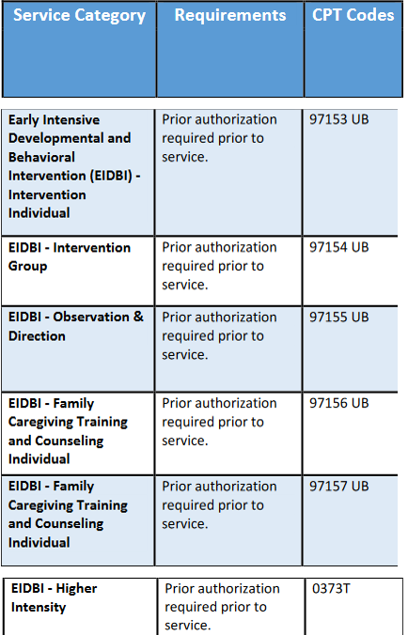
Requesting Prior Authorization
Most EIDBI services require prior authorization before treatment can be completed.
To request Prior Authorization, complete the Prior Authorization form for EIDBI (under UCare Authorization & Notification Forms) and send it with relevant documentation:
Via fax to: (612) 884-2033 or 1 (855) 260-9710
Via email to: MHSUDservices@ucare.org
What documentation is required for authorization review?
Please send most recent Individual Treatment Plan (ITP) and Comprehensive Multiple Disciplinary Evaluation (CMDE) with fully completed prior authorization request form for review

Slide 20
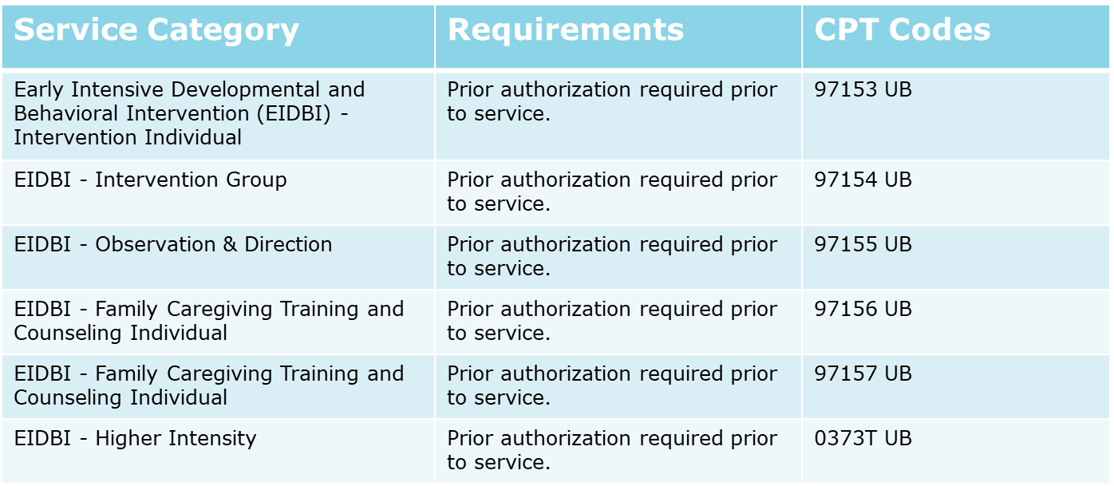
Services Requiring Prior Authorization
The following EIDBI codes/services require authorization prior to billing – please see UCare's Authorizations Page for details:

Slide 21
Authorization FAQ
Do I need to request a Prior Authorization for the CMDE and ITP?
In-network providers do not need to request prior authorization for CMDE prior to billing for this service. As of 1/1/23, providers can also bill for the individual treatment plan (ITP) without prior authorization.
Where can I find the form on UCare website?
The Prior Authorization form for EIDBI can be found from UCare.org -> Provider Home -> Authorizations -> MH & SUD Authorizations -> UCare Authorization & Notification Forms.
How long will it take for my request to be reviewed?
UCare has 10 business days to decide; however, we will typically make our decision sooner.

Slide 22
Claim Processing at UCare

Slide 23
Rejected and Accepted Claims
Rejected Claim
Indicates the claim has been rejected by the Clearinghouse or UCare.
Review the reason for rejection at your Clearinghouse, correct the claim and resubmit the claim as an original.
The UCare Provider Portal only shows the status of accepted claims.
For assistance with a rejected claim, contact your Clearinghouse.
If your Clearinghouse is unable to resolve the rejected claim, email EDISupport@ucare.org.
Accepted Claim
Indicates the claim has been accepted into UCare's Payment System and is being adjudicated and processed based on correct coding guidelines.
The status in the UCare Provider Portal will indicate Pending while the claim is being processed.
Notes:
For UCare to reconsider decision there are three options to re-submit the claim to UCare or appeal the decision.
Replacement Claim;
A resubmission of an incorrectly paid claim due to a billing error.
Voided Claim;
Returning a claim payment to UCare
Provider Claim Reconsideration Form
When you disagree with the claim denial
You will need to complete and submit this form for UCare to overturn or uphold the denial

Slide 24
Paid and Denied Claims
Paid Claim
The Provider Portal indicates a Paid status along with the Explanation of Payment (EOP). See Provider Guide: The Explanation of Payment (under Forms & Links).
If the Provider Portal indicates a Pending Payment status, payment can be expected on next Remit Payment date.
The standard Claims Payable Calendar (available under Payment & Remittance) displays the dates providers can expect remittance payment.
Denied Claim
The Provider Portal indicates a Denied status along with the Explanation of Payment (EOP).
Review reason and correct, if appropriate, per guidance in the Provider Manual.
For claim questions contact the Provider Assistance Center:
Send a secure email within the Provider Portal Message Center.
Call 612-676-3300 or 1-888-531-1493 toll-free.
Notes:
For UCare to reconsider decision there are three options to re-submit the claim to UCare or appeal the decision.
Replacement Claim;
A resubmission of an incorrectly paid claim due to a billing error.
Voided Claim;
Returning a claim payment to UCare
Provider Claim Reconsideration Form
When you disagree with the claim denial
You will need to complete and submit this form for UCare to overturn or uphold the denial

Slide 25
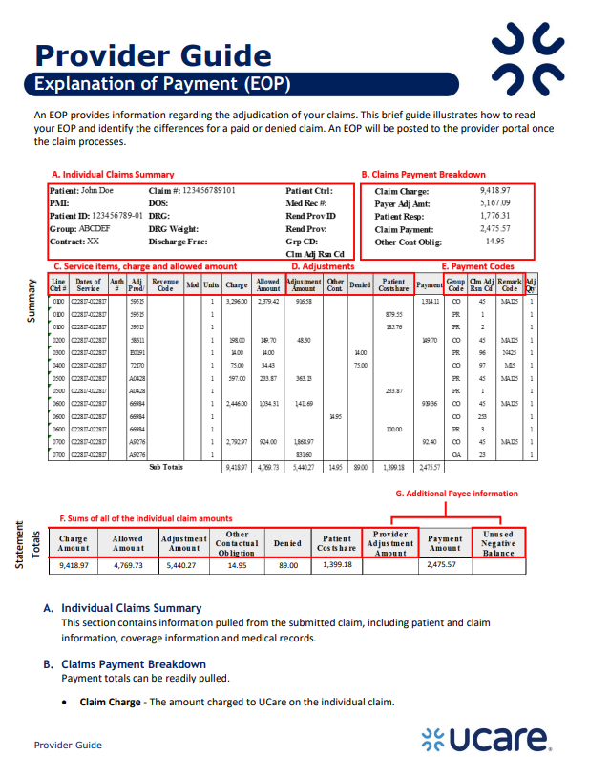
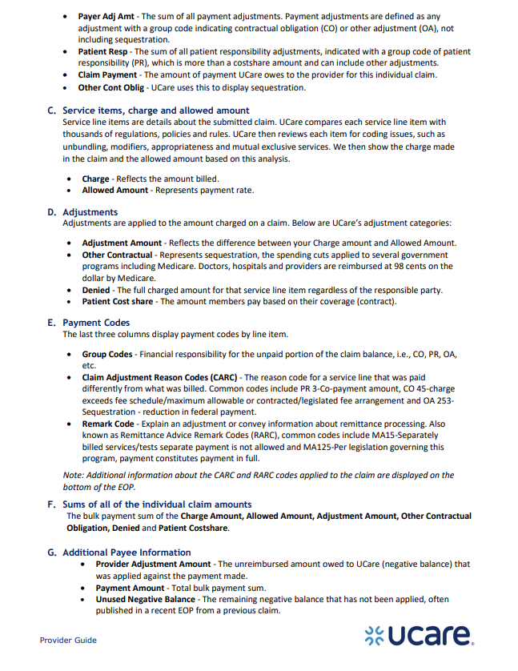
Explanation of Payment (EOP) Guide
Click here for the current EOP Provider Guide under Forms & Links.

Slide 26
Provider Claim Reconsiderations
To appeal a claim payment or denial, submit a Provider Claim Reconsideration Form.
The Provider Claim Reconsideration Form is available on the Claims & Billing page under Forms & Links.
Refer to the Tips for Using The Online Claim Reconsideration Form (under Forms & Links) for guidance when completing the form.
If additional assistance is needed, contact the Provider Assistance Center:
Send a secure email within the Provider Portal Message Center.
Call 612-676-3300 or 1-888-531-1493 toll-free.

Slide 27
Timely Filing
Timeframes
Initial claims must be received no later than 6 months after the date of covered services in the format approved by UCare and in compliance with state and federal law.
Adjustment requests submitted by the provider must be received within 12 months from the initial claim’s payment or denial date.
Requests received outside of this timeline will result in timely filing denial.

Slide 28
Important Claim Reminders
All EIDBI claims must be submitted electronically to UCare through a clearinghouse on the CMS-1500 form.
NUCC Instruction Manual for CMS 1500 Form
UCare does not accept paper claims for Minnesota providers.
Guidance for electronic claims submission is provided in the EDI chapter of the UCare Provider Manual.
The UCare Provider Manual is updated quarterly.
The PDF has a “clickable” Table of Contents.
Use “Ctrl F” to search key words.

Slide 29
Important Claim Reminders
Bill only for services already provided to the member.
Bill only for services approved by MN DHS.
Providing more services than approved may result in a claim denial.
Each date of service must be billed on a separate line.
A week is considered Monday-Sunday when an approval lists the number of units of service approved per week.

Slide 30
Important Claim Reminders
Review key CMS-1500 claim fields prior to submission (not all inclusive)
21A: Diagnosis code must be listed for all EIDBI claims
24A: One date of service per line
23: Service Authorization Number
24D: Accuracy in procedure code and modifier (if applicable) based on the EIDBI Billing Grid (state.mn.us) for service provided
24F: Charges - Rate for service provided
24G: List number of unit(s) or daily unit provided for date of service

Slide 31
Important Claim Reminders
Additional CMS-1500 claim fields to review prior to submission:
33: Billing provider address and phone number
33a: Billing provider NPI
If you are billing with a NPI, you must include taxonomy on claim.
33b: Billing provider UMPI
If you are billing with an UMPI, no taxonomy needed on claim.

Slide 32
Working with UCare

Slide 33
Clearinghouse Requirement
UCare requires all claims be submitted electronically through a clearinghouse.
A clearinghouse allows you to submit secure claims electronically.
There are several clearinghouse options available for you to choose from that follow MN AUC guidelines.
MN E-Connect/Health EC is available free to providers.
For more information visit, Resources for Electronic Transactions.
If you have questions about Electronic Data Interchange (EDI) transactions, please email EDISupport@ucare.org.
Change Healthcare is UCare’s primary clearinghouse partner.
Click here to access MN AUC Best Practices

Slide 34
Clearinghouse Set Up
Provide the key information below to your clearinghouse to ensure proper transmission of claims to UCare:
Important Note: If DHS identifies you with an UMPI, you should enroll with UCare and the clearinghouse using your UMPI. If DHS identifies you with an NPI, you should enroll with UCare and the clearinghouse using your NPI.
UCare Payer ID
55413
Type of Billing ID | Loop/Segment
UMPI | 2010BB REF01 - G2 REF02 – UMPI
NPI | 2010AA NM109
Element | Value
ISA07 | ZZ
ISA08 | UCAREMN
GS03 | UCAREMN

Slide 35
UCare Provider Portal
Once contracted, your organization’s designated portal administrator must register for the UCare Provider Portal.
The Provider Portal is a secure website that allows your organization to access information needed to work with UCare members.
You can view claims, EOPs and authorizations, verify member eligibility and secure email with our Provider Assistance Center.
You will be notified within 30 business days via email when the registration process is complete.
The portal administrator has access rights to add, update and remove users within your organization.
The administrator must be an employee of the organization.
Third-party billers cannot be the administrator on an account but can be added as a user by the administrator.
Provider Portal Quick Reference Guide (PDF)

Slide 36
Payment and Remittance Selections
Within the UCare Provider Portal you can request electronic payment and remittance by completing and submitting the Provider Payment and Remittance Request Form.
You will be notified via email when the process is complete.
If no selections are made, paper checks and electronic provider portal remittances are issued.
If you have a Tax ID change, a new Payment and Remittance Request form needs to be completed when electronic payment is preferred.
If a new form is not submitted, the default is paper checks and electronic provider portal remittances
If you have questions, email EFT835@ucare.org.
Click here to access the Provider Portal Login Page
Notes:
Choose a Payment Option
Electronic Funds Transfer (EFT) or Paper Check
Choose a Remittance Option
Paper Explanation of Payment “EOP” posted in the UCare Provider Portal or;
Electronic Remittance Advice (ERA) transmitted to your clearinghouse

Slide 37
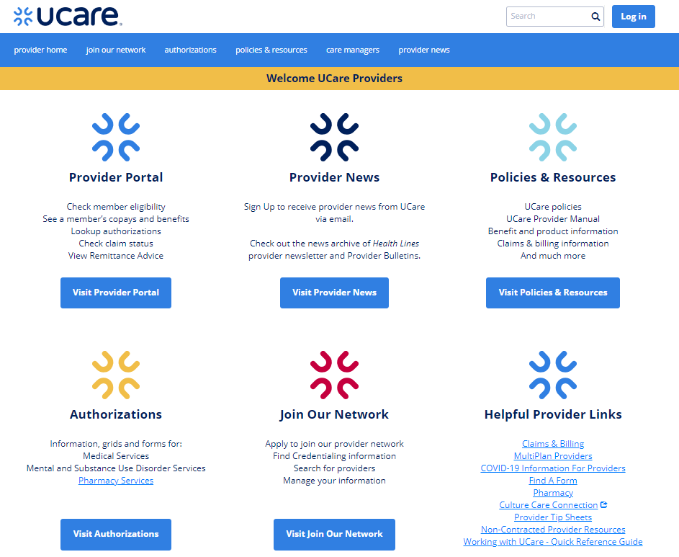
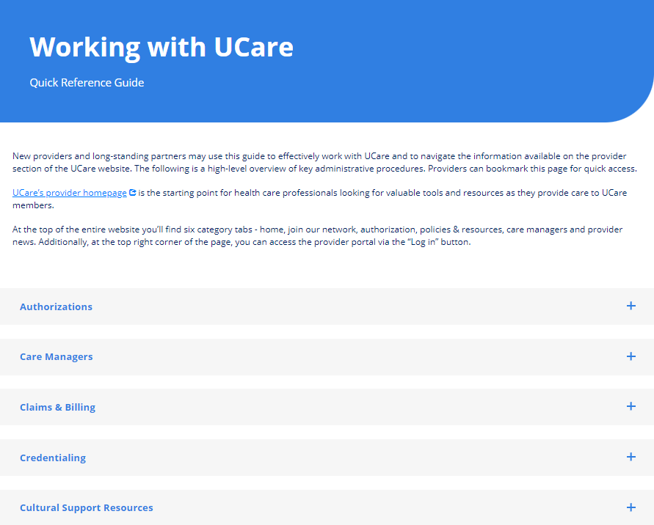
UCare’s Provider Website
Visit UCare’s Provider Website to access resources and guidance on how to work with UCare.
Bookmark Working with UCare Quick Reference Guide to access information covered in this presentation.
UCare Provider Website URL: www.ucare.org/providers

Slide 38
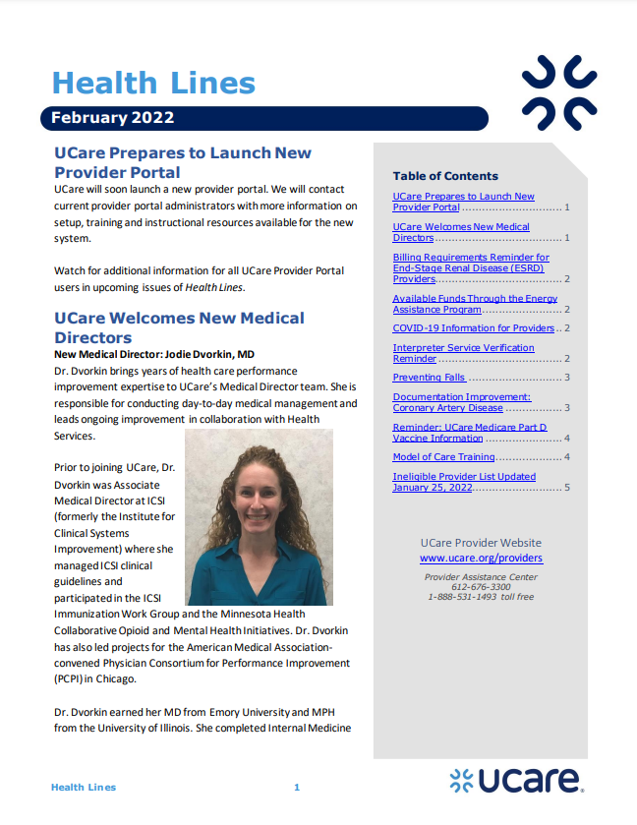
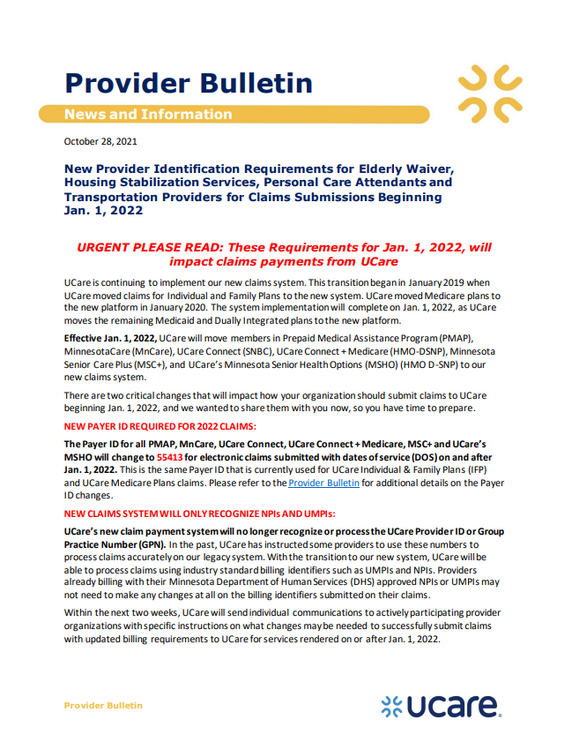
Sign Up for Provider News
Sign up to receive the following important information and more:
Health Lines, the monthly provider newsletter
Provider Bulletins, in-depth information about policies and news
Annual reminders, like the Critical Business Reminders

Slide 39
New Provider Checklist
Provider must be a DHS enrolled provider in order to provide EIDBI services to UCare members
Click here to Join Our Network
Click here to enroll in in a free electronic clearinghouse if you don't have a clearinghouse, Minnesota requires providers submit claims electronically
Register here to gain access to the UCare Provider Portal*
Click here to make Payment & Remittance selections or changes in the UCare Provider Portal*
Click here to notify UCare of changes to location and/or billing information or to add a new location
Sign up here to receive critical notifications and provider news

Slide 40
Contacting UCare

Slide 41
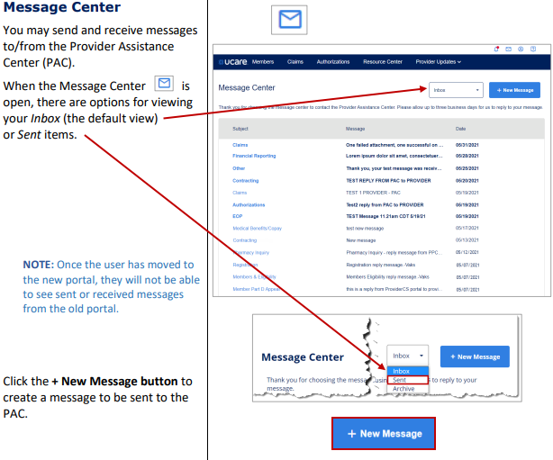
UCare Portal- Send a Secure Email
We encourage providers to contact us within the Provider Portal Message Center.
Turnaround time is targeted at 3 business days for inquiries.
***For complex claims issues – Please attach examples
Click here to access the Provider Portal Login page

Slide 42
Provider Assistance Center - Call Us
Contact the Provider Assistance Center
Call: 612-676-3300 or 1-888-531-1493 toll-free
Hours: 8 am - 5 pm, Monday through Friday
Common Inquiries
Claim Status (Pending, Paid, Denied)
EFT and remittance issues
Member eligibility, benefits, copayments, coinsurance and deductibles
Coordination of Benefits (COB) questions
Provider appeals questions
Provider demographic questions
Referrals, authorizations and notifications
Website navigation assistance

Slide 43
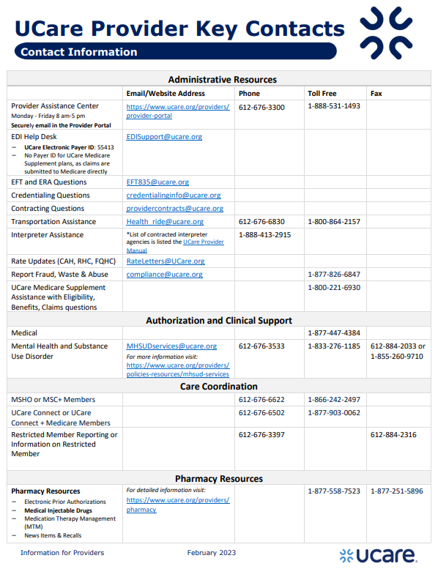
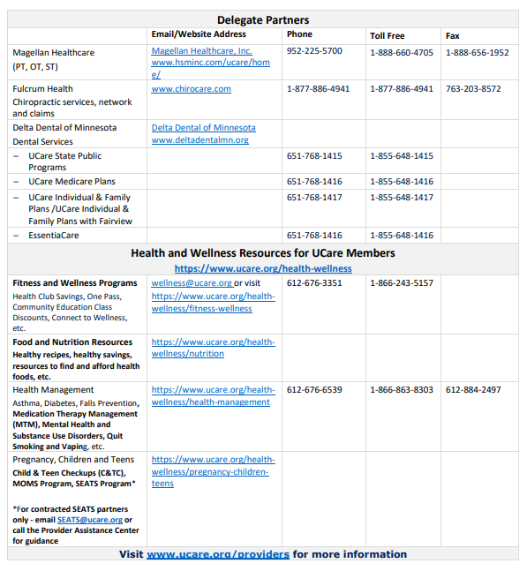
Click here to access the Key Contact Information document for Providers.

